Slide 1
Data Science WorkFlow
Problem statement, Analysis, Approach and Results.

Slide 2
Outline
The Problem
Exploratory Analysis
Approach
Results

Slide 3
The Problem

Slide 4
Problem statement
Using Auto MPG dataset to predict the fuel efficiency with multiple regression models.
The data concerns city-cycle fuel consumption in miles per gallon, to be predicted in terms of 3 multivalued discrete and 5 continuous attributes.
Prediction Target: MPG

Slide 5
Description of DataSet
Attribute Information:
mpg: continuous
cylinders: multi-valued discrete
displacement: continuous
horsepower: continuous
weight: continuous
acceleration: continuous
model year: multi-valued discrete
origin: multi-valued discrete
A relatively small dataset, with 398 examples.

Slide 6
Exploratory Analysis

Slide 7
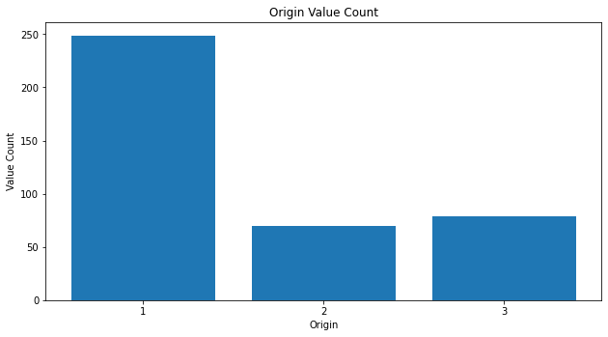
Exploratory Analysis
01
Value Count:
We can then use one-hot encoder to encode the categorical values to model acceptable binary values.
1
Analyzing the origin column tells us that it is a categorical column.

Slide 8
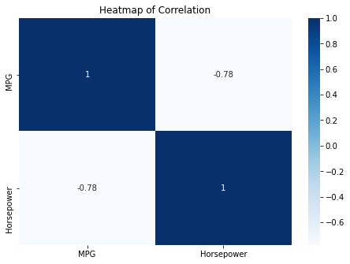
Exploratory Analysis
02
Correlation:
Input Feature Horsepower has a high correlation, and hence we’ll drop the rows from the dataset instead of imputing.
Analyzing the other columns we can see that Horsepower is the only column having null values which needs to be addressed.

Slide 9
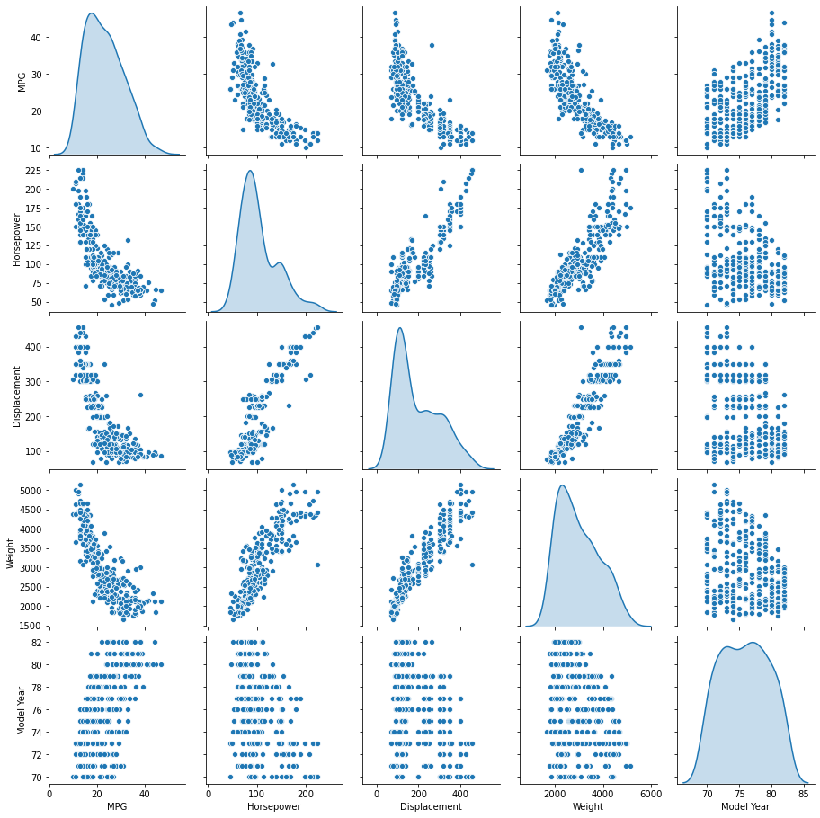
Exploratory Analysis
03
From a correlation plot, we are able to find out the correlation between the input features and the ones that’ll influence our model more.

Slide 10
Approach

Slide 11
Description
Finally, after data has been preprocessed, we’ve normalized the data to 1NF (0-mean; 1-standard deviation) using tensorflow normalizer with adapt layer.
Now, we’ll be creating 4 different models to predict the MPG based on our training data (80%), and validating it against our testing data (20%).
Predicting 1 output for each example, on the line y = mx + c with m as the matrix of features
We’re using the Tensorflow-Keras API and sklearn module from python.
Linear Regression
Random Forest Regression
Decision Tree
Deep Neural Network

Slide 12
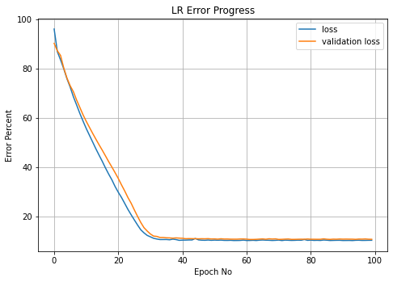
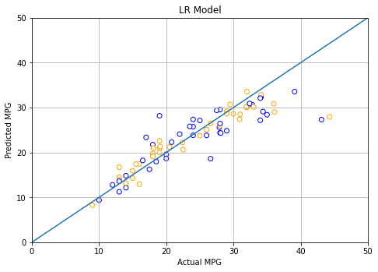
Approach
01
We’ll use the Keras Linear Regression model first, with 1 output layer and a total of 29 parameters and a learning rate of 0.1.
We’ll be calculating the error as Mean Absolute Percentage Error
The model gives us an 89% accuracy with a steady decline in loss, finally settling at 10.64%

Slide 13
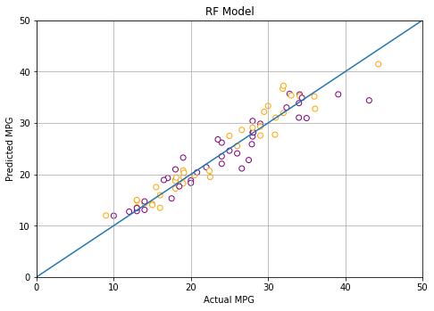
Approach
02
We’ll use the sklearn’s Random Forest Regressor, random_state as 1.
We’ll be calculating the error as Mean Absolute Percentage Error.
The model gives us a 92% accuracy with a final loss, settling at 7.82%. The Random Forest regressor shows significant improvement over the Linear Regressor.

Slide 14
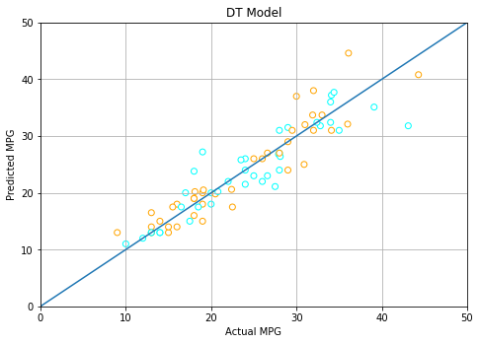
Approach
03
The Decision Tree gives a marginally better output than the Linear Regressor.
We’ll be calculating the error as Mean Absolute Percentage Error.
The model gives us a 90% accuracy with a final loss, settling at 10%. However, the Random Forest approach prove to be significantly better.

Slide 15
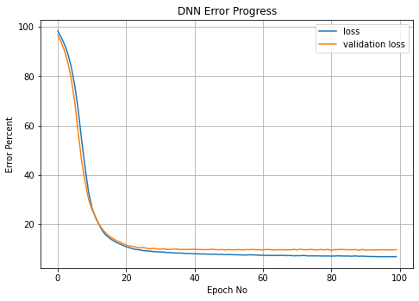
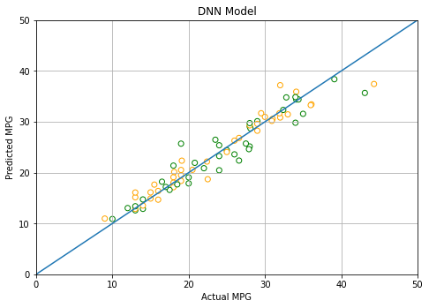
Approach
04
Finally we’ll be creating a Deep Neural Network, again with Tensorflow’s Keras API.
Here we're using a learning rate of 0.001 with two hidden non linear layers with 'relu' non-linearity and 1 output layer.
Calculating the error with Mean Absolute Percentage Error, we get a final loss of 7.14%, with an accuracy of 93% (approx).

Slide 16
Results

Slide 17
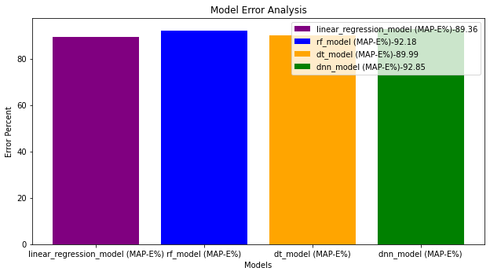
Conclusion
To conclude, all 4 of our models have given us respectable results.
Linear regression model: 89.36%
Random forest model: 92.18%
Decision tree model: 89.99%,
Deep Neural Network model: 92.85%
However we can see that the DNN model has the highest accuracy whereas the Linear regression model has the lowest.

Slide 18
Thank You.

Slide 19
References
Please check the jupyter notebook: Predict Fuel Efficiency.ipynb
Dataset: http://archive.ics.uci.edu/ml/machine-learning-databases/auto-mpg/

